Slide 1
Database Concepts
JPP SIG CP2

Slide 2
What is a database
“A set of information held in a computer”
Oxford English Dictionary
“A collection of data arranged for ease and speed of search and retrieval”
Dictionary.com

Slide 3
Applications
Web indexes
Library catalogues
Medical records
Bank accounts
Stock control
Personnel systems
Product catalogues
Telephone directories
Train timetables
Airline bookings
Credit card details
Student records
Customer histories
Stock market prices
Discussion boards
and so on…

Slide 4
How does a database work ?
A database system consists of
Data (the database)
Software
Hardware
Users
We focus mainly on the software
Database systems allow users to
Store
Update
Retrieve
Organise
Protect
their data.

Slide 5
Users
End users
Use the database system to achieve some goal
Application developers
Write software to allow end users to interface with the database system
Database Administrator (DBA)
Designs & manages the database system
Database systems programmer
Writes the database software itself

Slide 6
Database Management Systems
A database management system (DBMS) is the software than controls that information
Examples:
Oracle
DB2 (IBM)
MS SQL Server
MS Access
Ingres
PostgreSQL
MySQL

Slide 7
File based systems
File based systems
Data is stored in files
Each file has a specific format
Programs that use these files depend on knowledge about that format
Problems:
No standards
Data duplication
Data dependence
No way to generate ad hoc queries
No provision for security, recovery, concurrency, etc.

Slide 8
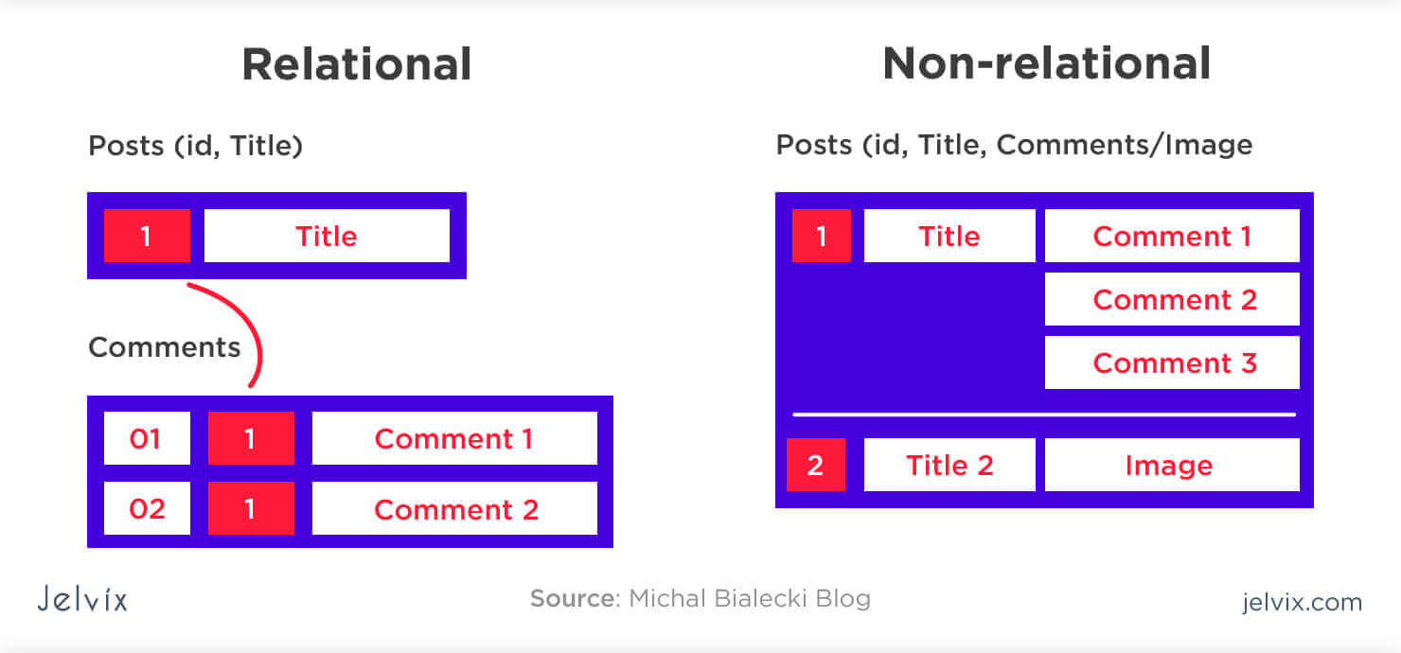
Relational database systems
Tables: Data is organized into tables, with each row representing a record and each column containing attributes.
Relationships: Tables are logically connected to each other based on shared attributes.
Keys: Each row in a table has a unique ID, called the key.
Constraints: Constraints restrict the data that can be stored in relations. For example, a constraint can limit an integer attribute to values between 1 and 10
MySQL, Microsoft SQL Server, and Oracle Database

Slide 9
Simple database queries
DDL Commands:
CREATE (creates a table)
ALTER (adds, deletes, modifies, and renames the attributes of the relation)
DROP (deletes the data)
DML Commands:
SELECT (retrieve data)
INSERT (add new data)
UPDATE (modify existing data)
DELETE (remove data)
…DCL, TCL … are complex queries…

Slide 10
Query | Function
SELECT * FROM table_name; | Retrieve all columns and rows from the specified table.
SELECT column1, column2 FROM table_name; | Retrieve specific columns from the specified table.
SELECT DISTINCT column FROM table_name; | Retrieve unique values from a specific column in the table.
WHERE condition; | Filter rows based on a specified condition in the WHERE clause.
ORDER BY column ASC/DESC;a | Sort the result set in ascending (ASC) or descending (DESC) order based on a specified column.
GROUP BY column; | Group rows based on the values in a specific column.
HAVING condition; | Filter groups based on a specified condition in the HAVING clause (used with GROUP BY).
INSERT INTO table_name (column1, column2) VALUES (value1, value2); | Insert new records into a table with specified column values.
UPDATE table_name SET column1 = value1 WHERE condition; | Update existing records in a table based on a specified condition.
DELETE FROM table_name WHERE condition; | Delete rows from a table based on a specified condition.
CREATE TABLE table_name (column1 datatype, column2 datatype, …); | Create a new table with specified columns and data types.
ALTER TABLE table_name ADD column_name datatype; | Add a new column to an existing table.
DROP TABLE table_name; | Delete an entire table along with its data.
SELECT COUNT(*) FROM table_name; | Count the number of rows in a table.
SELECT AVG(column) FROM table_name; | Calculate the average value of a numeric column in a table.

Slide 11
Non relational database systems
A non-relational database, also known as a NoSQL database, stores data in a format that's best for the type of data being stored, rather than in tables.
Non-relational databases are designed to store unstructured or loosely defined data, such as images, videos, email messages, and business documents. They can also store a mix of structured and unstructured data

